Slide 1
A Tool For Discovering High Quality Reviews
BIA-660 Web Analytics Final Presentation
Zijing Huang, Po-Hsun Chen,
Hao-Wei Chen, Chao Shu
Department of Computer Science
2017.12.03

Slide 2
Motivation & Objectives
Introduction
Methodology
Experiment Results
Conclusion & Future Work
Contents of the project

Slide 3
Motivation & Objective
For Customers: Customers are more likely to read reviews with details instead of reviews that were written to just vent emotions.
For Companies:
Objective reviews are helpful in improving their products.
High-quality reviews can increase customer engagement and attract more users.
Objective: A tool for discovering high quality reviews

Slide 4
Introduction(1/3)
This project aims to develop a tool for discovering high quality review.
The dataset includes 4,700,000 reviews provided by Yelp Dataset Challenge.
Methodology: Deep learning with Convolutional Neural Networks (CNN) and Word Embedding.

Slide 5
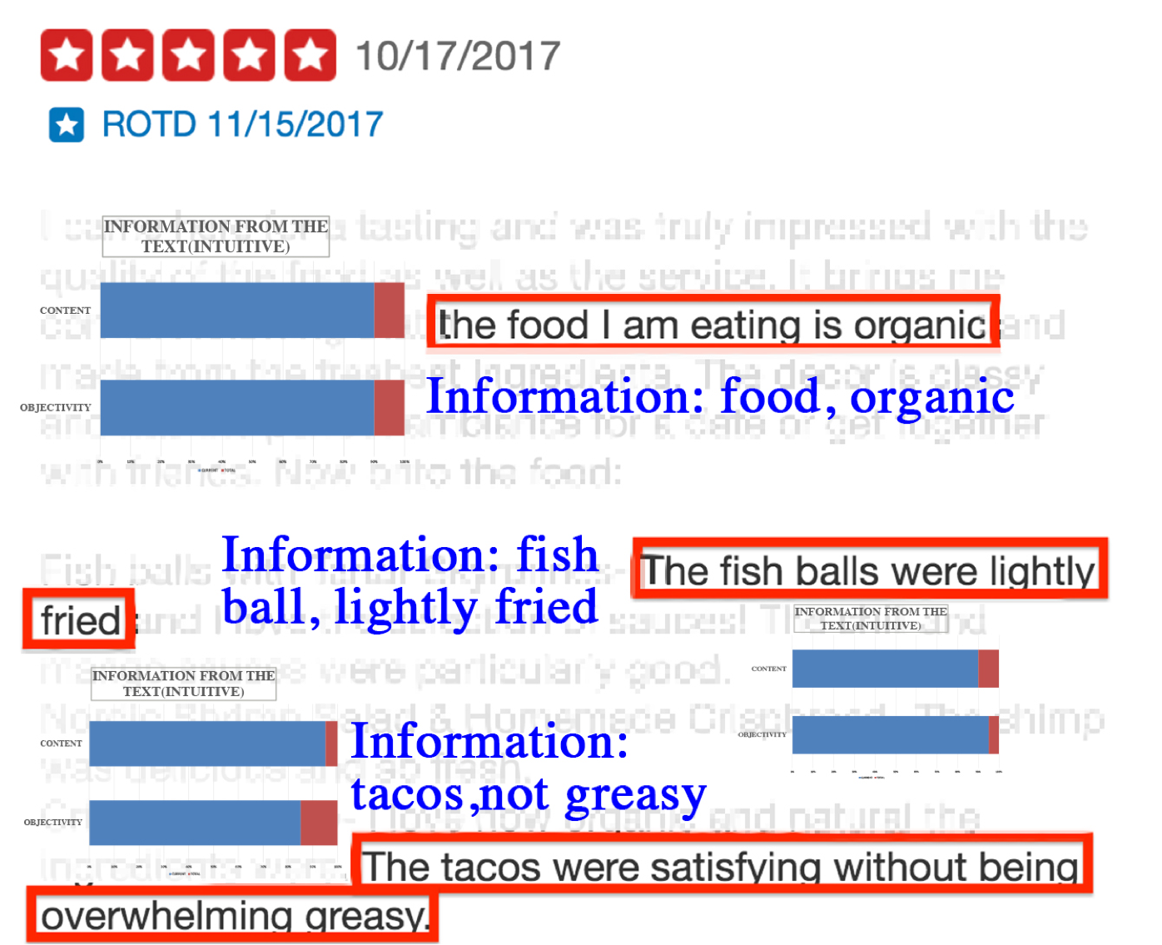
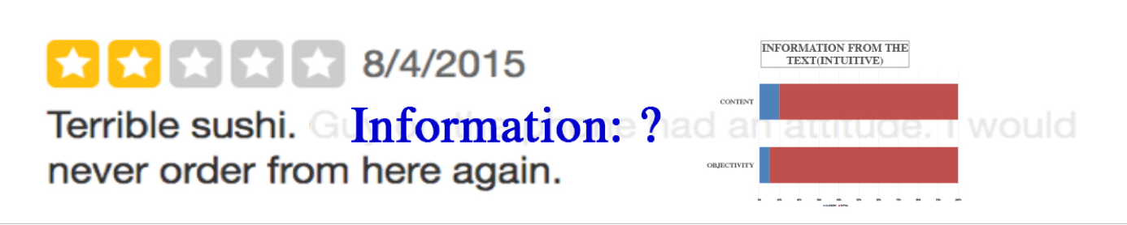

Introduction(2/3)
High Quality vs. Low Quality
Un-useful information
Useful Information we got from the review

Slide 6
Introduction(3/3)
use the raw data to train word vectors that capture the semantics of words
manually labeled a small number of sentences with aspects (i.e. price, amenity) and sentiment
train two Convolutional Neural Networks (CNNs) to detect aspects and sentiment of each sentence in a review
the aspects and sentiment of each sentence were used as features to determine the quality of a review. The prediction can be visualized through a user interface

Slide 7
Methodology(1/3)
Use Yelp raw data to train word vectors that capture word semantics
Create a CNN to identify aspects from every sentence of a review
Train another CNN to detect sentiment of each sentence
Build an a neural network model to predict the quality of a review base on aspects and sentiment of its sentences.
Compare this approach with other models (SVM, Naïve Bayes …) and analyze the pros and cons of each model
Visualize the result through user interface

Slide 8
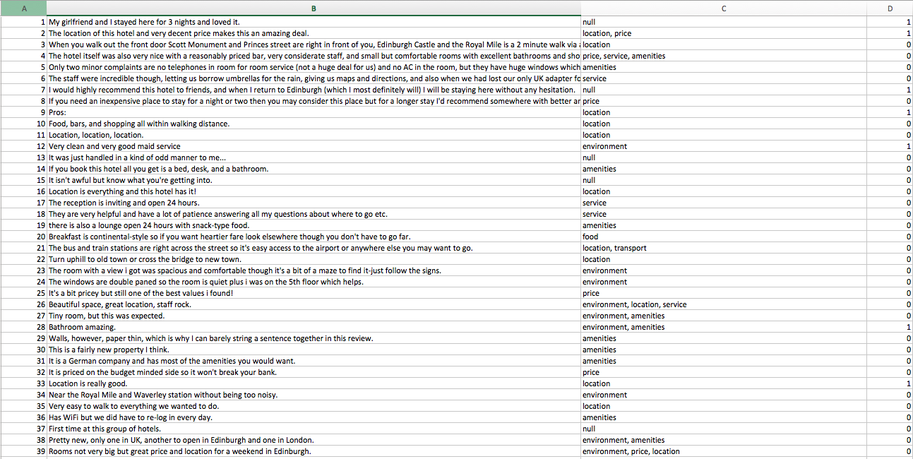
Methodology(2/3)
Manually labeled the data before training
Sentences of reviews
Labels
Sentiment
Label the reviews sentence by sentence.
1 means the sentiment is positive or negative, 0 means the sentiment is neutral.

Slide 9
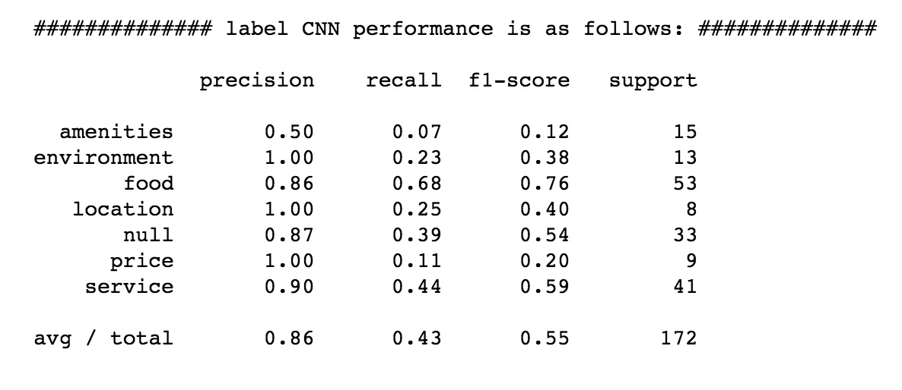
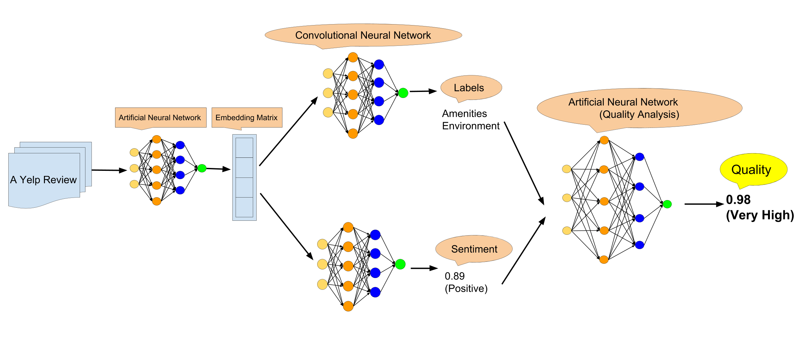
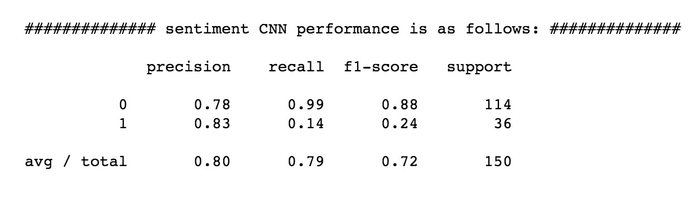
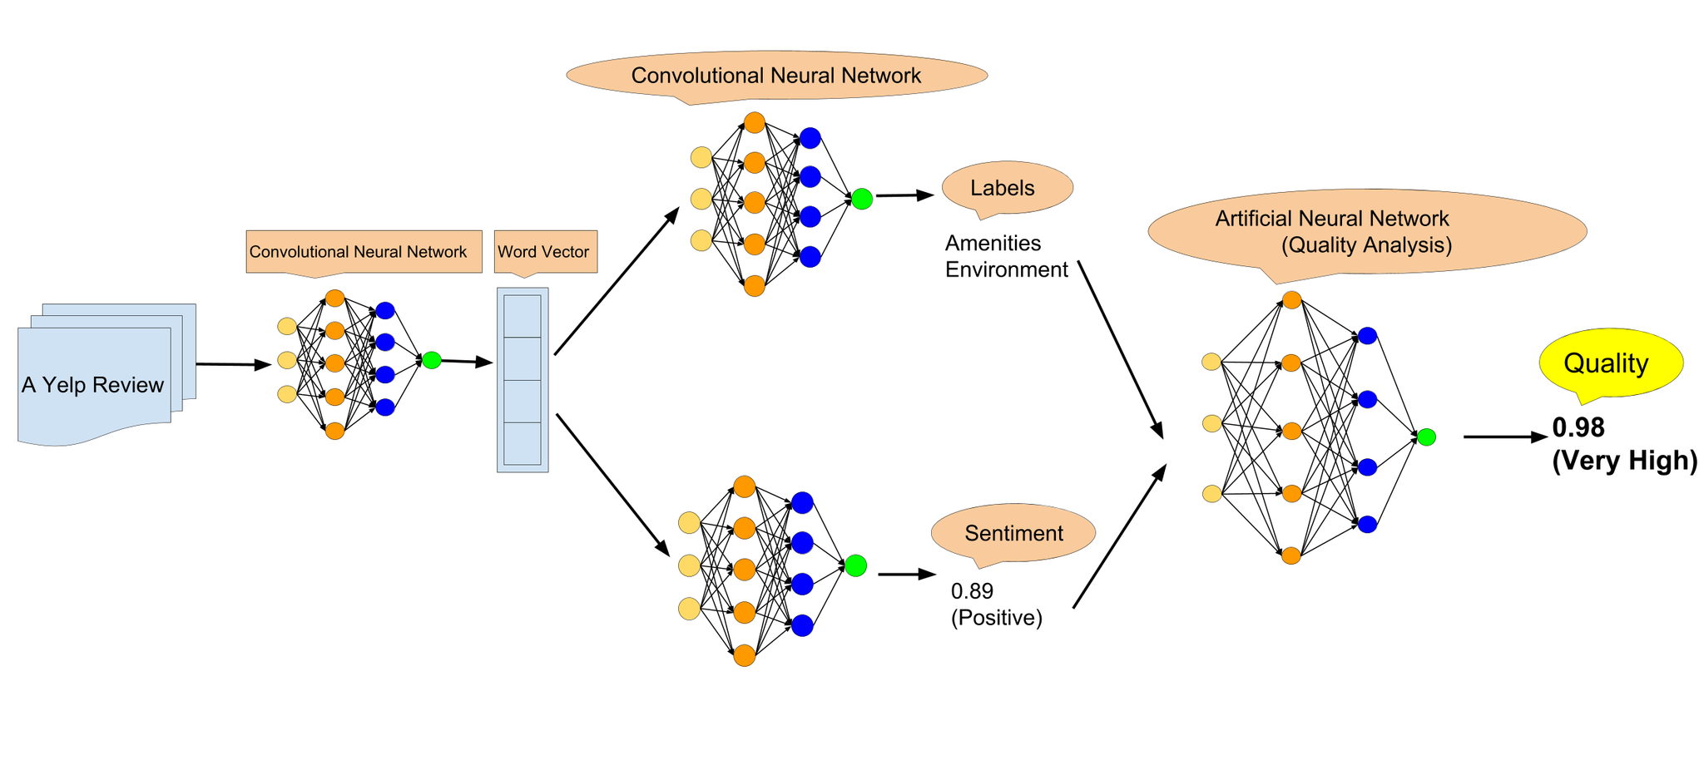
Methodology(3/3)

Slide 10


Experiment Results(1/2)
Evaluation using Naïve Bayes
We use the same data set and split it into 70% as the training set and 30% as test set.
Use Tf-idf vector with MultinomialNB to classify the sentiment and use multi-label classification for classifying labels.
Transform labels into indicator matrix. The error rate is calculated per predicted indicator matrix which is not fully matched with the actual one.
[1, 1, 0, 0, 0, 0]

Slide 11
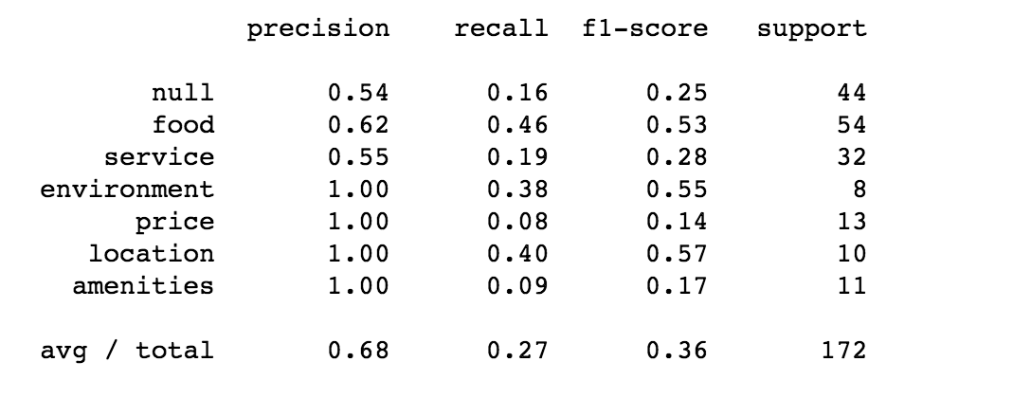
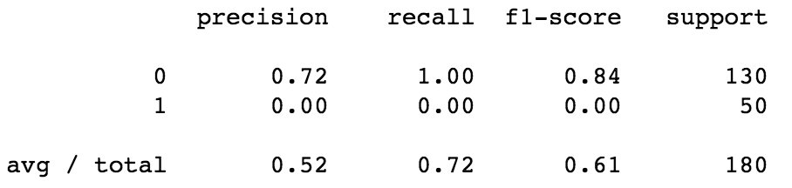
Experiment Results(2/2)
Performance Evaluation
Naïve Bayes
The performance of classifying label:
The performance of classifying sentiment:
Convolutional Neural Works
The performance of classifying label:
The performance of classifying sentiment:

Slide 12
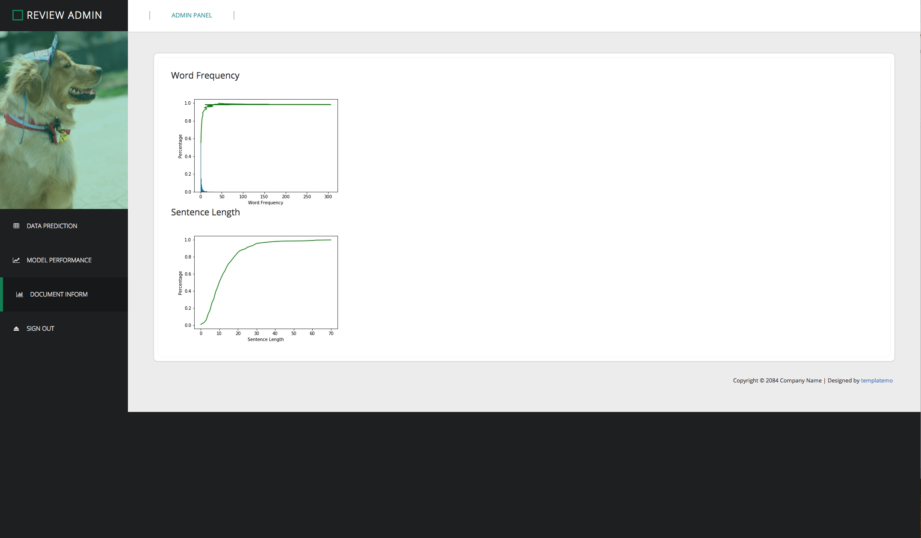
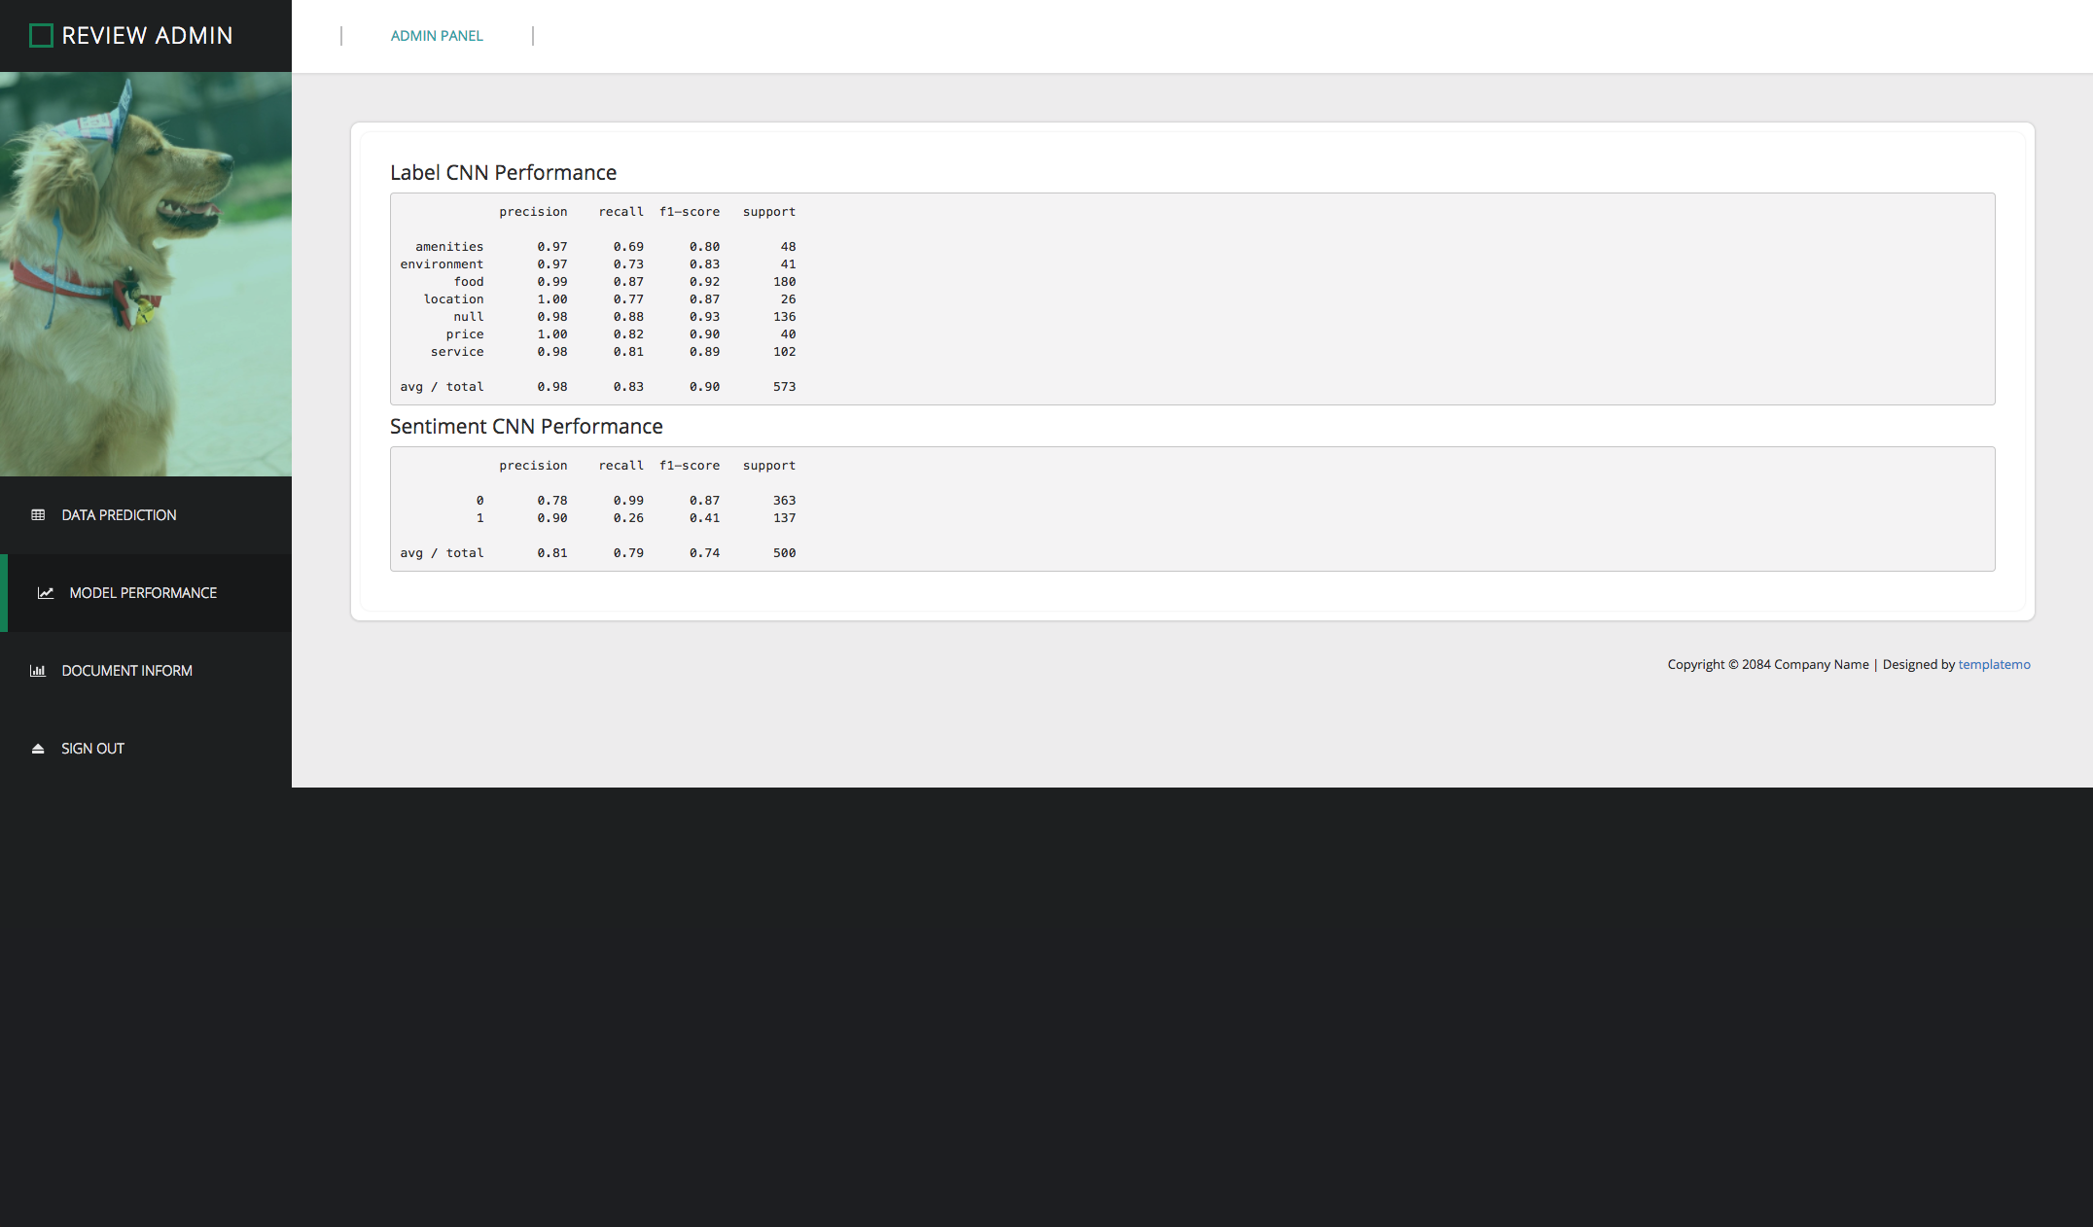
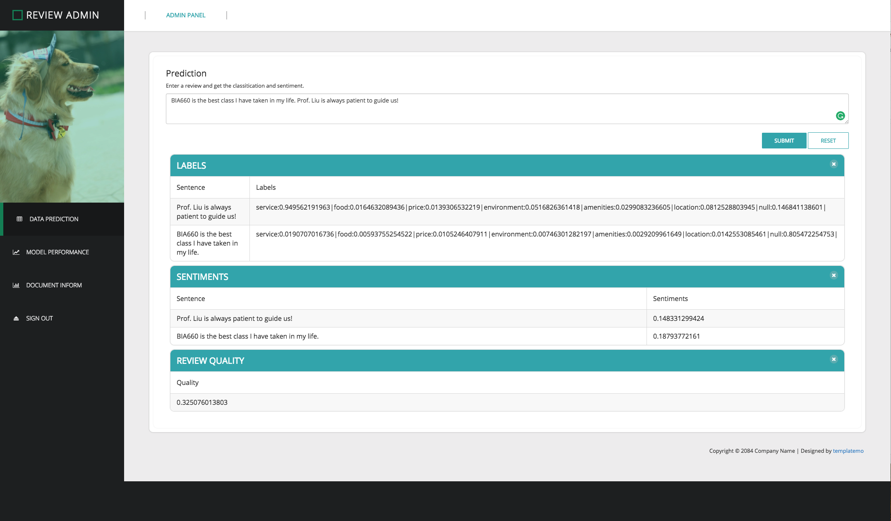
Experiment Results(2/2)
User Interface
Framework: Flask
NodeJS
Bootstrap
Input sentence or paragraph
Output Labels, Sentiments (it will split the input sentence by sentence) and Review Quality

Slide 13
Conclusion & Future Work(1/2)
Workable
Label Classifying (CNN)
Sentiment Classifying (CNN)
Un-workable
The performance of quality of the sentence is not very precise.
The samples of every label are not enough. (At least 100 samples)
Need more agreements
Adding more extreme sentences

Slide 14
Conclusion & Future Work(2/2)
Add more training sets (sample quantity)
Let more people to do the sample agreements (sample quality)
When the data samples get increased, the CNN training time increases as well. So, we will put it into a distributed system.
Publish a python package (or a Restful API) for third party use

